Slide 1
Data Link Layer

Slide 2
Session Objectives
After going through this session you will be able to understand:
Node to node communication
Nodes and Links
Data link control layer
Media access control layer

Slide 3
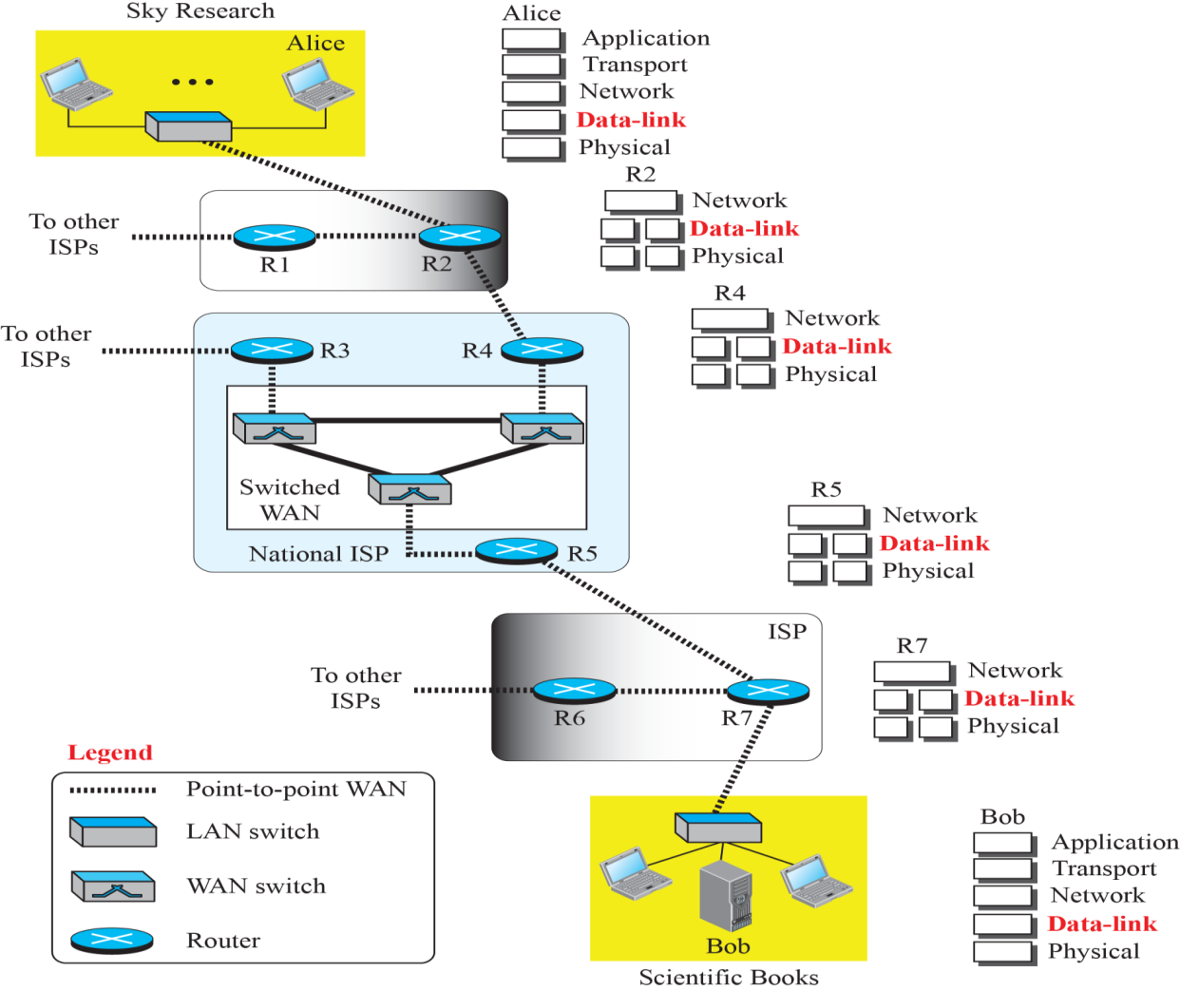
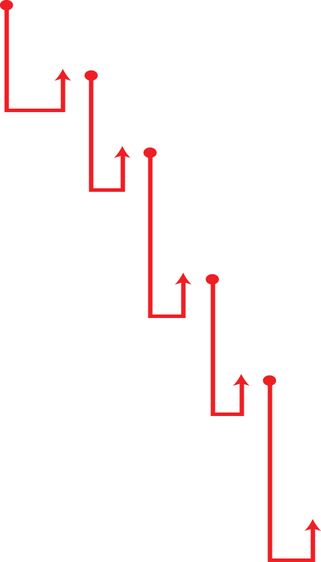
Node to Node Communication
The Internet is a combination of networks glued together by connecting devices (routers or switches).
If a packet is to travel from a host to another host, it needs to pass through these networks.

Slide 4
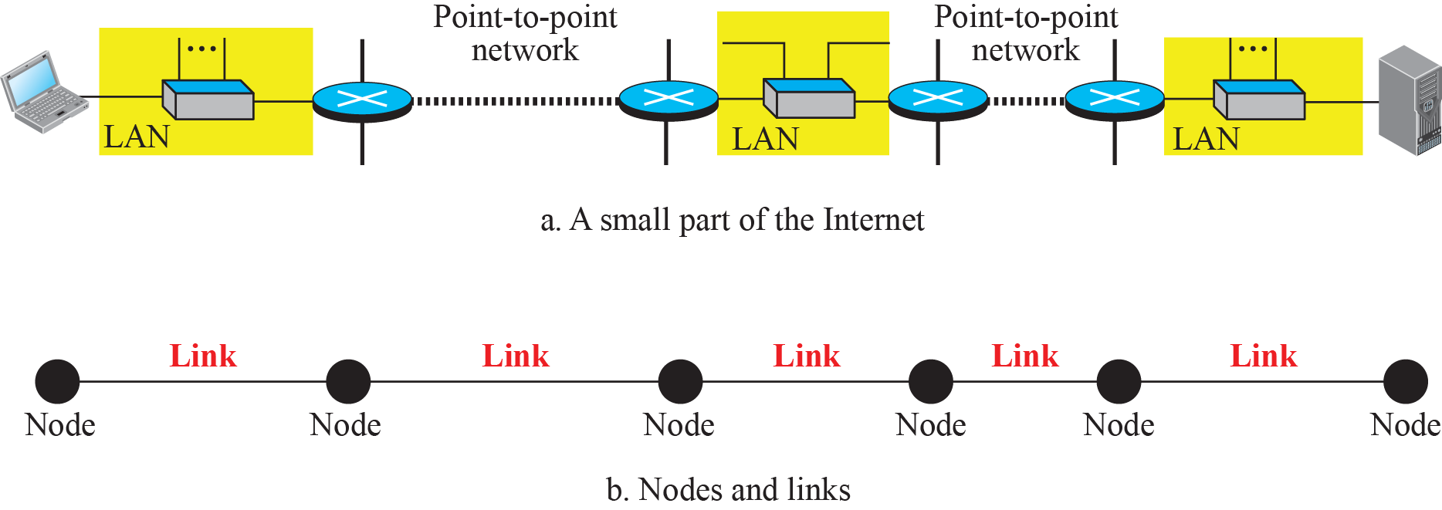
Nodes and Links
Communication at the data-link layer is node-to-node.
A data unit from one point in the Internet needs to pass through many networks (LANs and WANs) to reach another point.
Theses LANs and WANs are connected by routers.
The routers are taken as nodes and the networks in between as links.

Slide 5

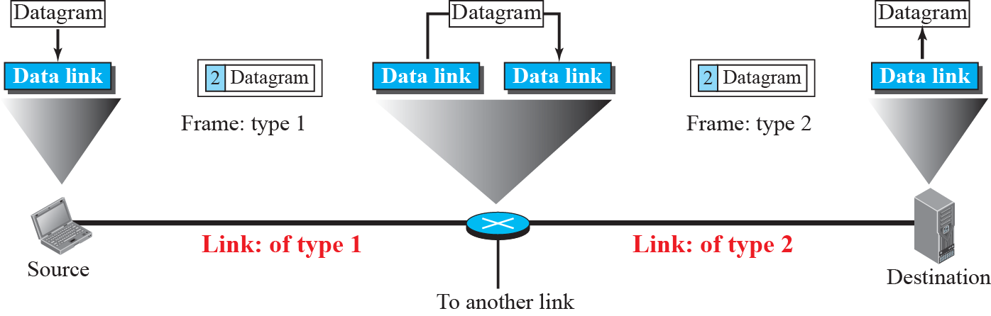
Data Link Layer Services
The data-link layer provides services to the network layer; it receives services from the physical layer.
Services at Data Link layer can be divided into two sub layers: data link control (DLC) and media access control (MAC).

Slide 6
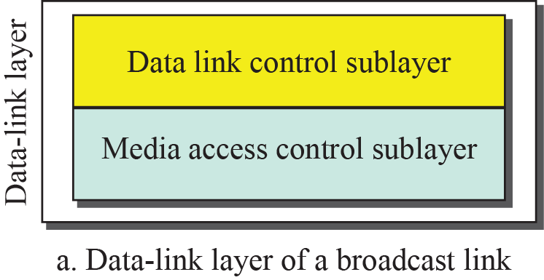
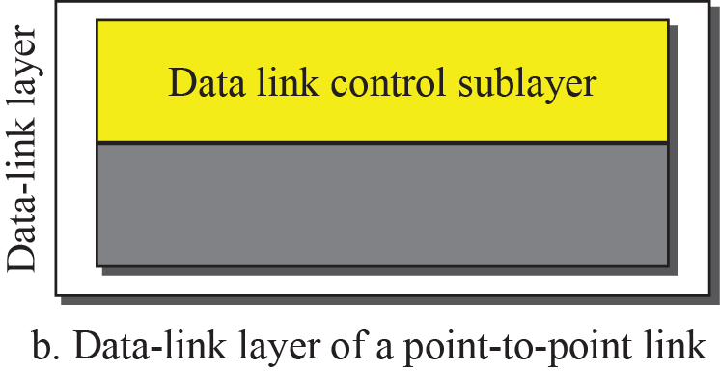

Slide 7
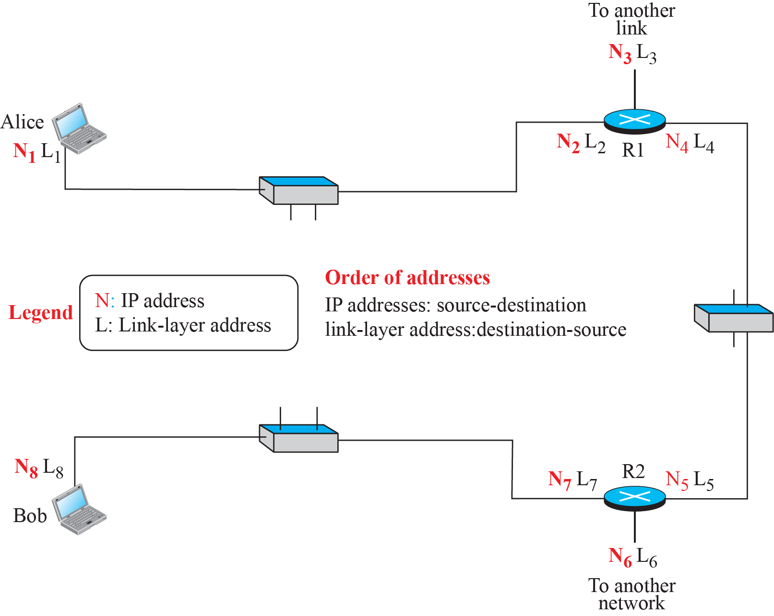
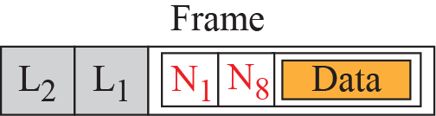
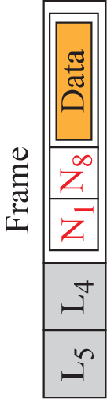
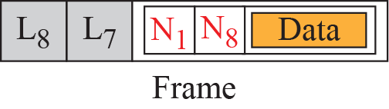
IP and Link Layer Addressing

Slide 8
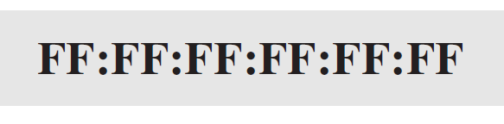
Three Level of Addressing
Link-layer protocols define three types of addresses: unicast, multicast, and broadcast.
The MULTICAST link-layer addresses are 48 bits (six bytes) that are presented as 12 hexadecimal digits separated by colons. The second digit needs to be an odd number.
A3:34:45:11:92:F1
The UNICAST link-layer addresses are 48 bits (six bytes) that are presented as 12 hexadecimal digits separated by colons. The second digit, however, needs to be an even number in hexadecimal.
A2:34:45:11:92:F1
The BROADCAST link-layer addresses are 48 bits, all 1s, that are presented as 12 hexadecimal digits separated by colons.
Notes:
4.#

Slide 9
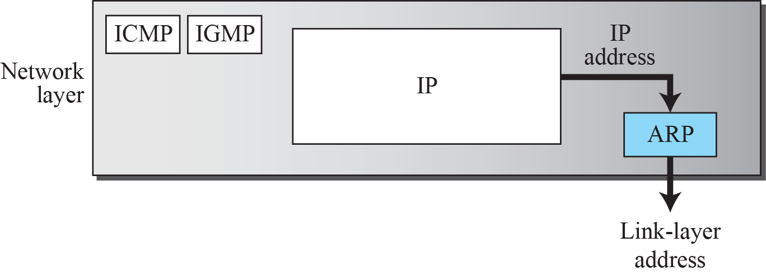
Address Resolution Protocol (ARP)
Anytime a node has an IP datagram to send to another node in a link, it has the IP address of the receiving node.
However, the IP address of the next node is not helpful in moving a frame through a link; we need the link-layer address of the next node.
This is the time when the Address Resolution Protocol (ARP) becomes helpful.
Position of ARP in TCP/IP protocol suite is shown below.
Notes:
4.#

Slide 10
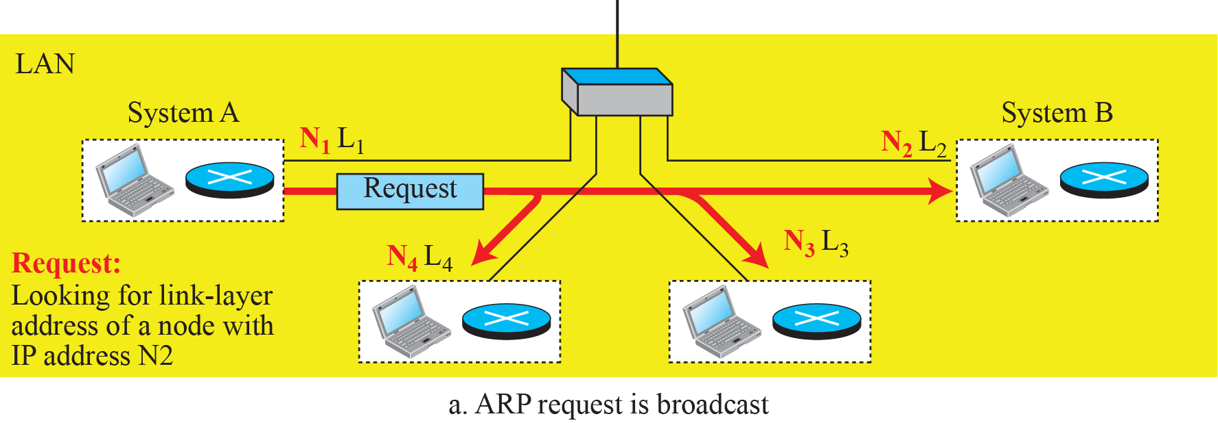
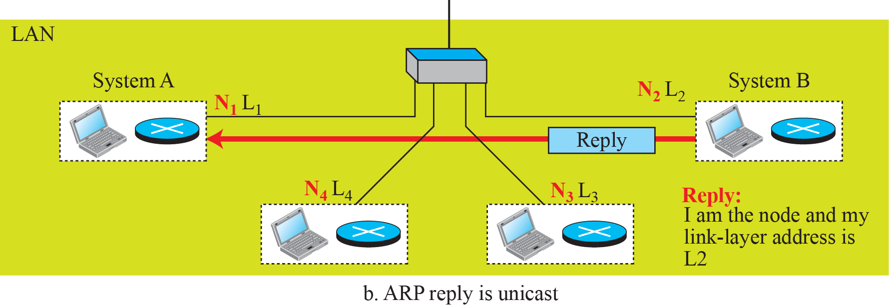
ARP Operation

Slide 11
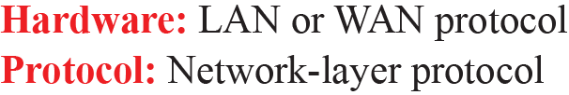
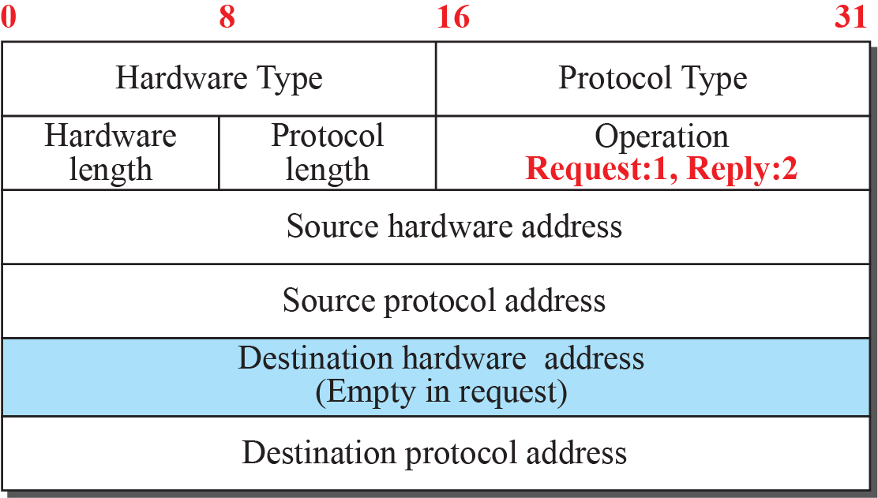
ARP Packet Format
Notes:
4.#

Slide 12
Summary
In this section we have discussed the following:
Link and Nodes
Communication at Data Link Layer
ARP protocol
Notes:
1.#

Slide 13

Notes:
1.#

